Slide 1

Computer Science Program Orientation
S
CS Undergraduate Student Affairs Coordinators
Liette Chin liette.chin@mcgill.ca
Teresa (Tess) Pian teresa.pian@mcgill.ca
June 2023
Notes:
Are your classroom colors different than what you see in this template? That’s OK! Click on Design -> Variants (the down arrow) -> Pick the color scheme that works for you!
Feel free to change any “You will…” and “I will…” statements to ensure they align with your classroom procedures and rules!

Slide 2


Slide 3

CS Program Organization
A common set of Core courses (for all Majors, Minors, and Joint programs), covering basic programming, algorithms, and math.
A set of Complementary courses to choose from, which give flexibility to specialize.
  Graphics, databases, AI, networks, and more!
Beyond core and complementary courses, Elective courses – electives can be taken in (almost) any department.
  You can take more CS courses, general interest courses, all kinds of things.

Slide 4

First CS Course at McGill
If you have a lot of experience programming, or have taken programming classes before, take COMP 250
If you have never programmed before or have minimal experience, take COMP 202 (or COMP 204 or COMP 208)
NOTE: COMP 202/204/208 cannot be taken for credit after you have taken COMP 250. You can NOT take COMP 202 and COMP 250 at the same time (and you cannot get credit for both if you do it).

Slide 5
COMP 202/204/208
Which one is right for me?
All of them cover roughly the same material, using Python.
COMP 202: can be taken by any student at McGill
  Only requires CEGEP level (or equivalent) math – Calc 1&2, Linear Algebra
  It is a Complementary course in the U0 Freshman Program.
COMP 204: can be taken by students with a background in life sciences
  BIOL 112 is a prerequisite, and you have to be comfortable with the basics of cell biology and genetics.
COMP 208: part of several B.Eng. and some B.Sc. programs in the physical sciences
  MATH 141 ‘Calculus 2’ (or equivalent) is a prerequisite and MATH 133 ‘Linear Algebra and Geometry’ is a co-requisite.

Slide 6

What courses should I take in first year?
Depends on if you were admitted as a U0 or U1 student
U0
You are coming from high school
with no advanced credits (or less than 30 credits)
You start with the Freshman Program
U1
You have advanced credits from CEGEP/ IB /AP
You go straight into your Major program

Slide 7

First, a word about workload
1 credit in a course translates to about 3 hours of work per week
  3 credit course = average workload of 9 hours a week (including class time)
  So 5 courses with 3 credits each means 45 hours of work per week!
  It is perfectly normal to take 4 courses (about 36 hours per week) to have time for extra-curriculars, clubs, etc.
Not all courses are the same difficulty – a higher course number does not necessarily mean the course is more difficult, just that it requires more background
Many CS courses involve programming assignments or projects, which can be time consuming
Overall, be aware of your limits and don’t overload and overwork yourself in a semester. You need time to live!

Slide 8

Second, a word about ‘vision’
If you know what you want to do after you graduate McGill (it’s ok if you don’t know for sure yet!), then:
  Look at the 400-level & 500-level courses you would like to take, and work backwards looking at prerequisite 200-level & 300-level courses
  You will see a path emerge for the courses you should take to get there!

Slide 9
U0: Freshman Program (Arts and Science)
The Freshman Program is a 30 credit program you must complete before you can take classes for the Major you want
  You have to take 30 credits from a specific list of Freshman courses
  Requirements differ depending on which ‘Group’ you were admitted in
  Science Freshman courses - Arts Freshman courses
If you want to study CS or Software Eng in your second year, make sure you take these Freshman courses in U0:
  COMP 202 Foundations of Programming (3 credits)** /COMP 204/COMP 208
    **Even if you have experience programming, we recommend taking COMP 202 in U0
  MATH 133 Linear Algebra (3 credits)
  MATH 140 Calculus 1 (3 credits)
  MATH 141 Calculus 2 (4 credits)
  NOTE: these reccomended courses only add up to 13 credits – you still need to take 17 credits of other Freshman courses to complete the 30 credits total required

Slide 10
U1: No or Minimal Prior Programming
**Only applicable if you are starting as a U1 student or did not take COMP 202 in U0**
FALL: COMP 202/ 204/ 208 + two MATH courses + electives (like classes for a Minor)
WINTER: COMP 250 + COMP 206 + one or two MATH courses + electives
MATH courses to take in U1 (either semester):
MATH 240, MATH 222, MATH 223

Slide 11
U1: Prior Programming Experience
FALL: COMP 250 + COMP 206 + MATH 240 + electives and/or another MATH course
  **you must take MATH 240 before COMP 251 – no exceptions
WINTER: COMP 251 + COMP 273 + one or two MATH courses + electives
MATH courses for U1:
MATH 240, MATH 222, MATH 223

Slide 12
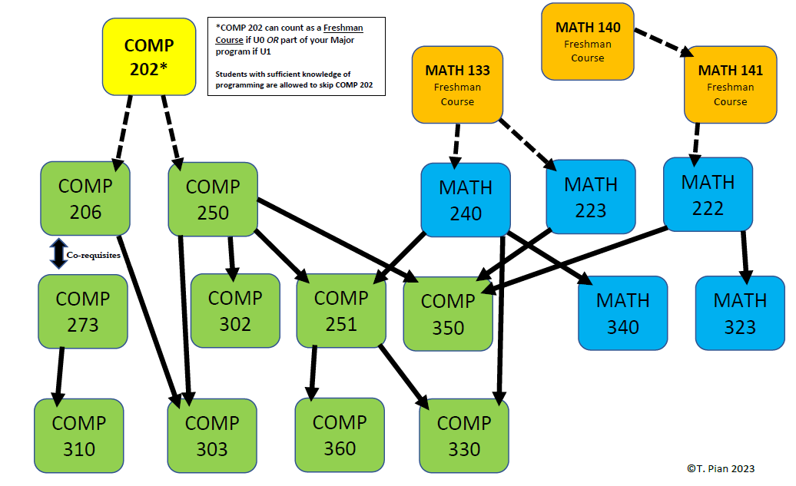
Understanding prerequisites for core Computer Science classes
**Prerequisite is a course that you must take BEFORE another course - because the content of the prerequisite course is necessary for the following course

Slide 13
Registering for Courses
Once registration starts, you can add courses for *both* Fall and Winter semesters
You have until the end of the Add/Drop period (second week of classes) to register for whatever courses you want
  Add/drop deadline for Fall courses is in September - Add/drop deadline for Winter courses is in January
If the class you want to register for is full, sign up for the waitlist if there is one
  Minerva will notify you when a spot opens and you are at the top of the waitlist. Waitlist how-to: https://www.mcgill.ca/students/courses/add/waitlisting
Always check Minerva for the most accurate course information, like times, locations, prerequisites, open spots
  VSB is a good tool for figuring out your overall schedule, but it’s not always accurate
If you have course registration issues, email Teresa (Tess) Pian teresa.pian@mcgill.ca

Slide 14

CS Programs
& Degree Options

Slide 15

Major vs. Honours vs. Liberal (Science)
Computer Science or Software Engineering Major (63 credits)
CS Honours (75 credits)
  Honours courses have a few different required courses, a research project, and require more CS credits
  GPA must always be 3.0 or above
CS Liberal Program (45 credits)
  Liberal Program in Software Engineering (49 credits)
Details of all program requirements are on the CS website, and you can select your program directly on Minerva!

Slide 16
Joint Programs
Interested in doing two Majors? Computer Science offers specific joint programs:
  CS & Biology (74 credits)
  Mathematics & CS (72 credits)
  Statistics & CS (72 credits)
  Physics & CS (66 credits)
Joint programs require less credits than two separate majors, but still have the same core courses for each major.

Slide 17
CS Minor
Want just a little bit of CS in your degree? Do a CS Minor
  24 credits for Science, 18 credits for Arts
Use the CS Minor Form to declare and plan your Minor
  To get the relevant Minor Form for your degree, email Liette Chin (Liette.chin@mcgill.ca) with your student ID number, current degree, and faculty
  Send the PDF with your course selections to the Minor Advisor for approval, email minor-advisor@cs.mcgill.ca
  See the whole procedure here: https://www.cs.mcgill.ca/undergrad/specializations/minor/
You can select your Minor on Minerva, but you should declare the Minor at the beginning of U2 or earlier

Slide 18
Major Concentration CS or SE (Arts)
For students in a Bachelor of Arts:
Major Con. in Computer Science or Software Engineering (36 credits
  The same core courses as the Bachelor of Science CS and Software Engineering programs, just with less required credits
Add on the Supplementary Minor Concentration in CS (18 credits) for a more robust program and more complementary course credits
  Major Concentration in CS (36 credits) + Supplementary Minor in CS (18 credits) = 54 CS credits total - almost equivalent to a CS Major

Slide 19

Diversify your Degree

Slide 20

Internships
Internships are paid positions related to your field of study
  Many students choose to do internships to get real-world work experience!
  They can be done after you finish U1
Industrial Practicum – 4 month internship
Internship Year in Science (IYS) – 8, 12, or 16 months
More info:
  For B.Sc. students ifso.science@mcgill.ca
  For B.A. students https://www.mcgill.ca/arts-internships/

Slide 21

Research Opportunities
Research courses are available in the Fall, Winter, or Summer (COMP 396, COMP 400 etc.)
  Under the supervision of a professor, you work on a project and summarize your findings at the end
  You receive credits and a mark on your transcript
Summer research awards
  Similar to research courses, but you get $ instead of credits
  NSERC USRA for all students, SURA for Science students, and ARIA for Arts students
Part-time research for $, or volunteering in Fall, Winter, or Summer
  You could have your own project, or could help in a professor’s existing lab

Slide 22

Career Advice
Check out the Career and Placement Centre (CAPS) for Computer Science and Software Engineering jobs
  Special events organized with companies, like the Tech Fair twice a year (September and January)
  CV and interview advice offered
Job and internship postings on https://caps.myfuture.mcgill.ca/
On-campus jobs available through the work-study office
Great events by McWics and CSUS!

Slide 24

Important Things to Know

Slide 25

Take Care of Yourself!
Your mental and physical health are more important than school
The Student Wellness Hub is your one-stop-shop for health and wellness services, health promotion activities, and more https://www.mcgill.ca/wellness-hub/
They have extensive program and support offerings, Self-Help tools, and an off-campus Health and Wellness Resource Map
Workshops on time management, mindfulness meditation, research skills, effective studying… whatever you need

Slide 26
Questions? Concerns? Ask an Advisor
Don’t be afraid to reach out to an academic advisor if you have any questions about your program requirements or degree progression – they’re here to help!
Advisors with the Faculty of Science (SOUSA) – for general questions and about the Freshman Program: https://www.mcgill.ca/science/undergraduate/advice/sousa
CS Advisors: https://www.cs.mcgill.ca/undergrad/program/advising/
  General questions: contact Teresa (Tess) Pian teresa.pian@mcgill.ca
  Questions about COMP 202 and COMP 250, or U0: email Prof. David Becerra david.becerra@mcgill.ca
  Questions about U1 and U2: email Prof. Joseph Vybihal jvybihal@cs.mcgill.ca
  For a Degree Audit (to see if you are fulfilling your program requirements): contact Liette Chin liette.chin@mcgill.ca

Slide 27

Email Etiquette
Don’t be afraid to reach out to professors or staff, but do it properly so that you get the best result!
  Use your McGill email
  Always include your McGill Student ID Number
  Be polite and professional – Hello Prof. LastName, Dear Mr./Ms. LastName
  Be concise – ask your questions and be direct about what you need, don’t send a super long email with every single detail (if we need to know more, we will ask!)
    When emailing about a specific course, put that course code in the subject line.
  Be patient – do not send multiple emails or re-send emails, we respond as soon as we can! There are over 4,000 students taking CS courses, that’s a lot of questions and concerns to answer.
    Follow-up only if you don’t receive a response after over a week.
More tips: https://www.mcgill.ca/onboardingcentral/files/onboardingcentral/student_email_etiquette_tips.pdf

Slide 28
Library Resources
Course reserves = your textbooks! mcgill.on.worldcat.org/courseReserves/landing
You can access the whole library catalog online at www.mcgill.ca/library/
  Schulich Library of Physical Sciences is closed, but you can find all the same resources at the Humanities and Social Sciences Library
Not just books! The McGill Library has many useful resources for you
  Printing
  Workshops (on research skills, citations, writing papers etc…)
  Book a study room or a space to Zoom
Jennifer Zhao (Jennifer.zhao@mcgill.ca) is the Library Liaison for CS and ECE. She can help you:
  Use the library’s collections, services, and spaces
  Search for research literature
  Manage and cite references
  Manage research data
  And more!
Find all Library service and open hours here: https://mcgill.ca/x/ovn

Slide 29

They have amazing information and resources for:
Help desk & free peer tutoring
Mental health support and resources
Sustainability
Equity
Research opportunities
Internships
Industry mentorship
CSUS is a great way to get involved and meet other CS students
First year council positions!
Weekly study nights
Hackathons
Connections to other CS student clubs!
For students & by students!
https://mcgill-csus.ca/

